Slide 1



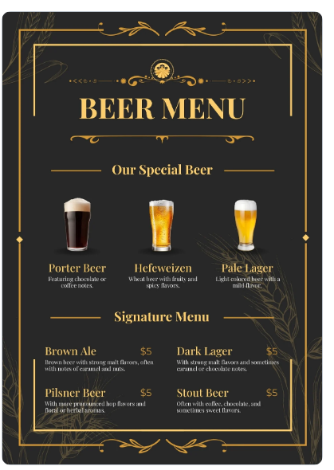


GROUP8

Slide 2
Segmentation & Discriminant Analysis – Kirin USA
Case Overview
Kirin, one of Japan’s leading beer brands, is aiming to grow its U.S. market share.
The challenge? Competing against Sapporo, which currently dominates in sales.
To succeed, Kirin needs a data-driven strategy to understand and reach the right customers.
Business Challenge
Who are the ideal customers? Identify target segments that offer the best market potential.
What do they want? Determine the key product attributes that appeal to different consumer groups
Strategic Goal
Use K-Means Clustering & Discriminant Analysis (DA) to uncover meaningful market segments.
Analyze customer preferences & demographics to refine product & marketing strategies.
Optimize targeting by selecting the most relevant customer descriptors, improving efficiency and impact.

Slide 3

Segmentation
Analysis

Slide 4
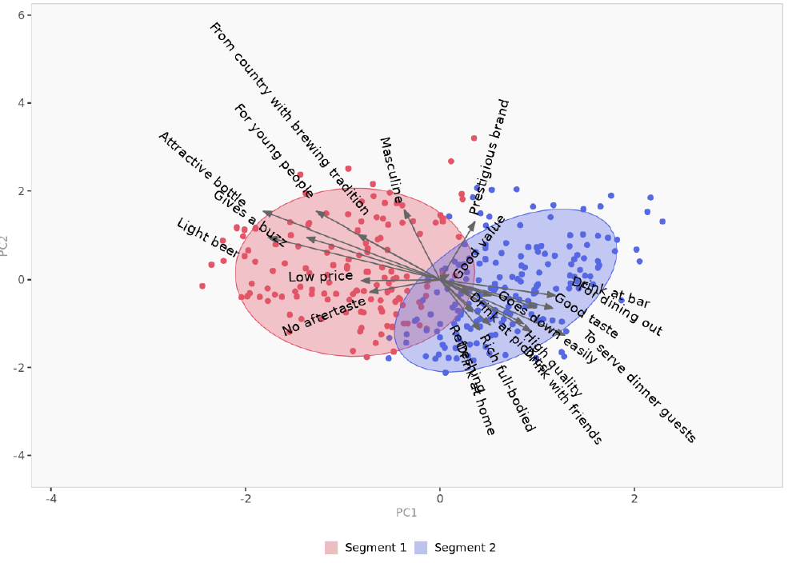
Segmentation Analysis - Key Insights(k=2)
Segmentation method relies on the K-means Approach
Approach : K-Means Clustering with 2 segments
Segment Sizes: Total Population (317)
Segment 1: 44% (140)
Segment 2: 56% (177)
Business Implications: Segment 1 can be targeted with low-cost, easy-drinking offerings. Segment 2 is a potential market for premium, high-quality beers.

Slide 5
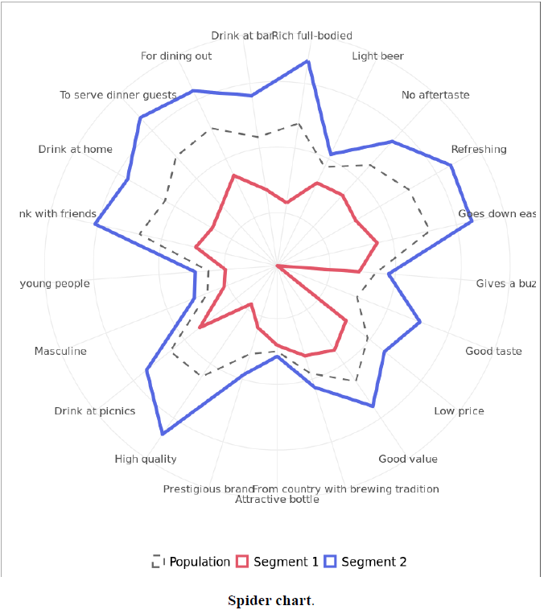
Conclusion : K-Means Clustering (K=2) Analysis identified two distinct consumer segments.
Segment 1 (44%) prefers light, easy-drinking beers that emphasize affordability.
Segment 2 (56%) enjoys full-bodied, rich, high-quality beers with greater brand consideration.
Spider Chart & PCA Segment Space confirm the differences between these segments.
Targeted Marketing Implications:
Segment 1: Focus on affordable, thirst-quenching beers.
Segment 2: Opportunity for premium, high-end beer offerings.
Impact on Brand & Product Strategy: Insights inform brand positioning and product design.

Slide 6
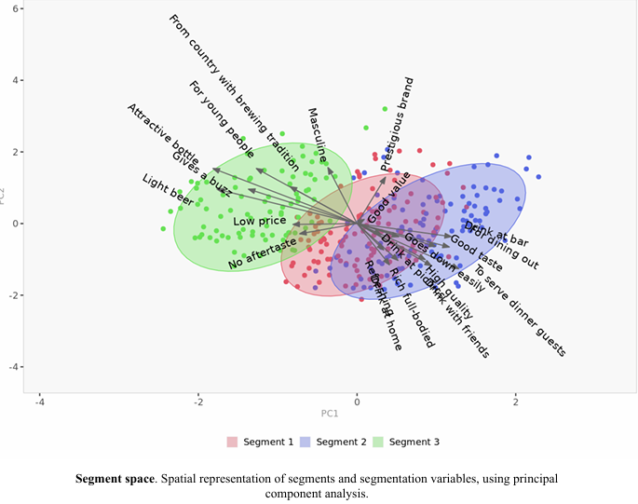
Segmentation Analysis - Key Insights(K=3)
Segmentation method relies on the K-means Approach
Approach : K-Means Clustering with 3 segments
Segment Sizes: Total Population (317)
Segment 1: 38% (119)
Segment 2: 34% (108)
Segment 2: 28% (90)
Business Implications:
Segment 1 Target smooth, refreshing beers easy to consume.
Segment 2 Target premium, high-quality products to meet their desire for strong, full-bodied flavor.
Segment 3 Position cost-effective, mass-market beers for price-sensitive consumers.

Slide 7
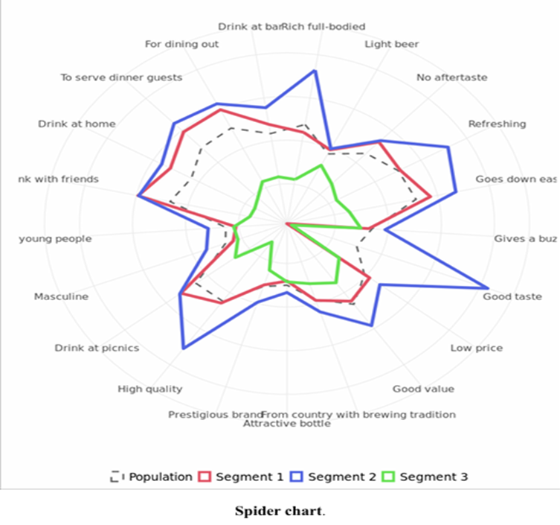
Conclusion :
K-Means Clustering (K=3) Segmentation Analysis identified three consumer segments.
Segment 1 (38%) prefers light, refreshing, easy-to-drink beers with moderate quality and value.
Segment 2 (34%) enjoys rich, full-bodied, premium beers with a strong taste and tradition preference.
Segment 3 (28%) is price-sensitive, prioritizing affordability over taste or branding.
Spider Chart and PCA Segment Space confirm these differences.
Marketing Strategy:
Segment 1: Smooth, easy-drinking beers.
Segment 2: High-end, premium beers.
Segment 3: Budget-friendly, mass-market beers.
Implications: Guides product positioning and marketing to meet each segment's needs.

Slide 8
Discriminant
Analysis

Slide 9
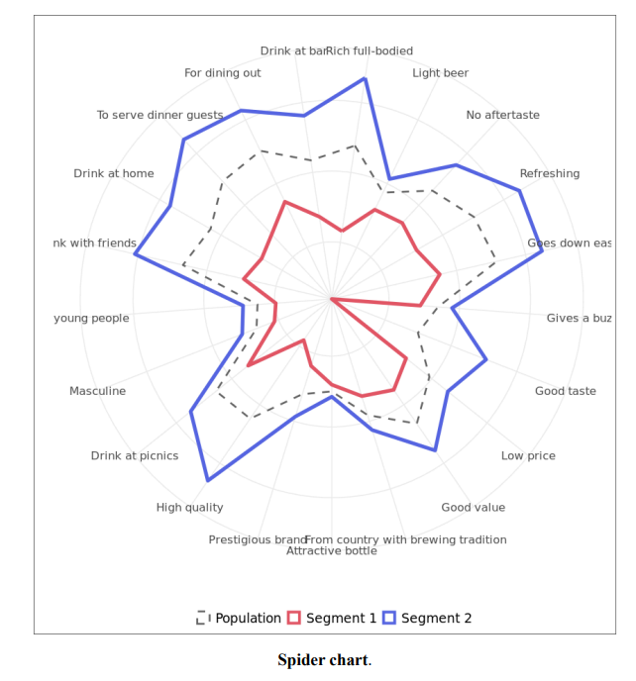
K=2
Objective: Identify consumer groups based on beer preferences.
Methodology:
K-Means Clustering (2 Segments, Forced).
Principal Component Analysis (PCA) for Descriptor Analysis.
Segment Size:
Segment 1 (44%) → More diverse in behavior.
Segment 2 (56%) → More uniform responses.
Business Implications:
Segment 1: Cost-conscious, prefers familiar options.
Segment 2: Values experiences, prefers high-quality beer.

Slide 10
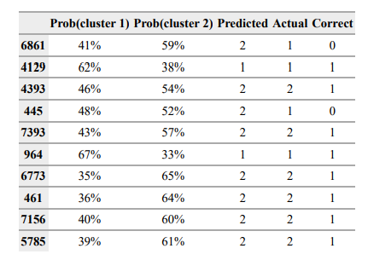
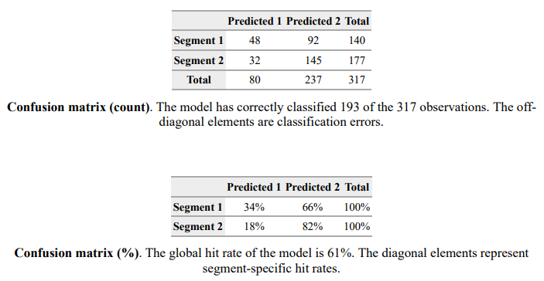
Confusion Matrix Insights
Overall Accuracy = 61% (193 out of 317 correctly classified).
Segment 2 (56% of population) → 82% correctly classified.
Segment 1 (44% of population) → Only 34% correctly classified.
Model struggles with Segment 1, misclassifying 66% into Segment 2.
More distinct descriptors are needed to improve classification
Prediction Probability & Model Performance
Key Findings from Probability Table
Some consumers have similar probabilities for both segments, making classification difficult.
Misclassification happens when probabilities are close (e.g., 48% vs. 52%).
Better separation in segment characteristics is needed for higher accuracy.
Segment 2 is more clearly defined than Segment 1, leading to better predictions.

Slide 11
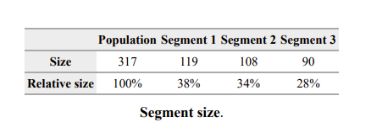
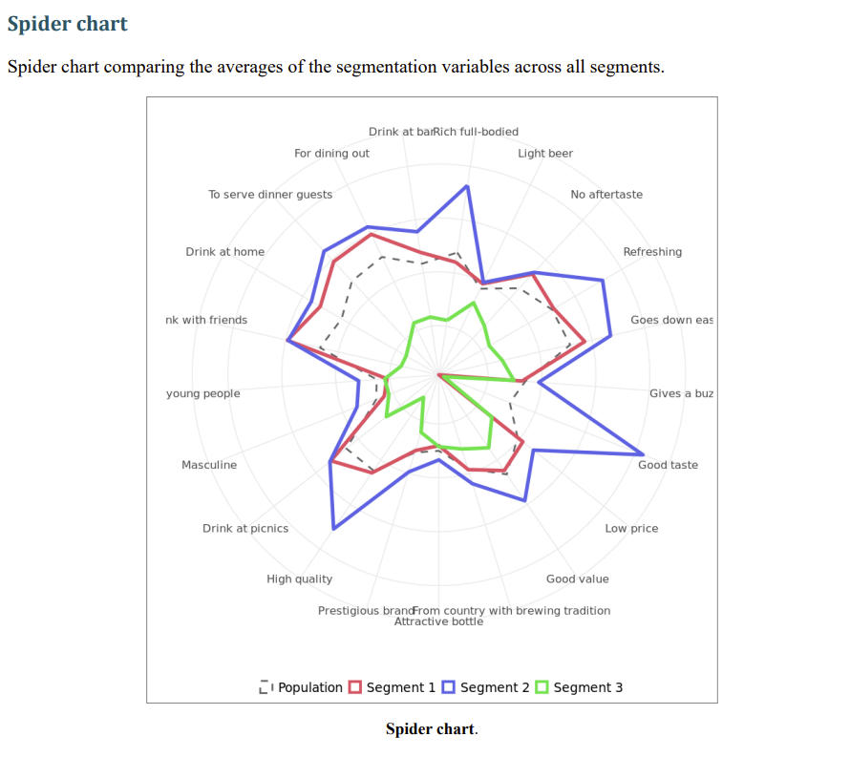
K=3
Objective:
Identify consumer groups based on beer preferences using clustering and discriminant analysis.
Methodology:
K-Means Clustering (3 Segments, Forced)
Principal Component Analysis (PCA) for Descriptor Analysis
Segment Size:
Segment 1 (38%) → Prefers social drinking, high-quality beer.
Segment 2 (34%) → Enjoys refreshing, strong taste, and good value.
Segment 3 (28%) → Less interest in beer, cost-conscious.
Business Implications:
Segment 1: Target with premium and high-quality beer marketing.
Segment 2: Focus on taste, refreshment, and value-based pricing.
Segment 3: Potentially difficult to engage, price-sensitive consumers.

Slide 12
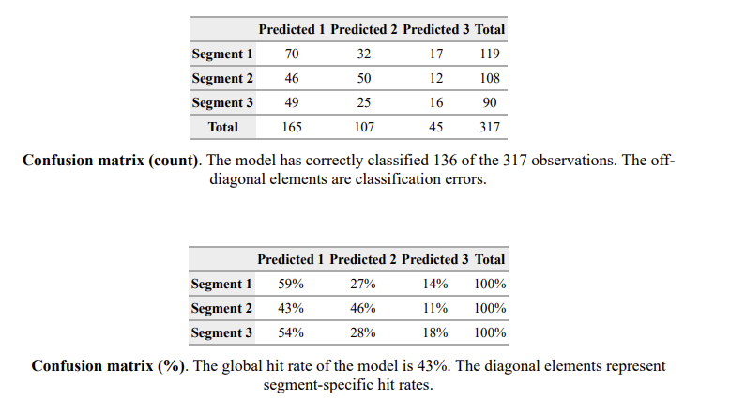
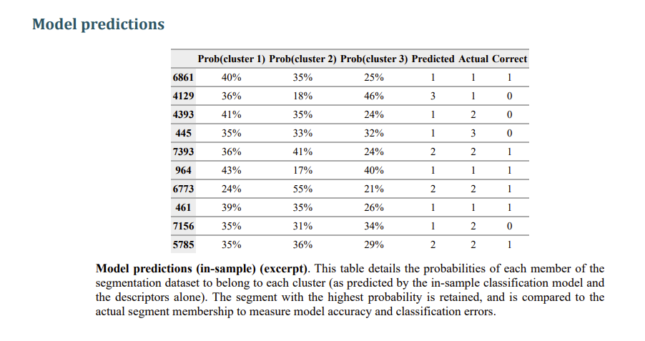
Confusion Matrix Insights:
Overall accuracy= 43% (136 out of 317 correctly classified).
Segment 1 (38% of population) → 59% correctly classified
Segment 2 (34% of population) → 46% correctly classified.
Segment 3 (28% of population) → Only 18% correctly classified.
Model struggles with Segment 3, often misclassified into Segment 1 or 2.
More distinct descriptor variables needed for improved accuracy.
Prediction Probability & Model Performance
Some consumers show similar probabilities across segments, making classification challenging.
Misclassification occurs when probabilities are close (e.g., 48% vs. 52%).
Better separation in segment characteristics is needed from improved classification.
Segment 1 and 2 are more defined, leading to higher accuracy compared to Segment 3.

Slide 13
Discriminant
Analysis
Improvement

Slide 14
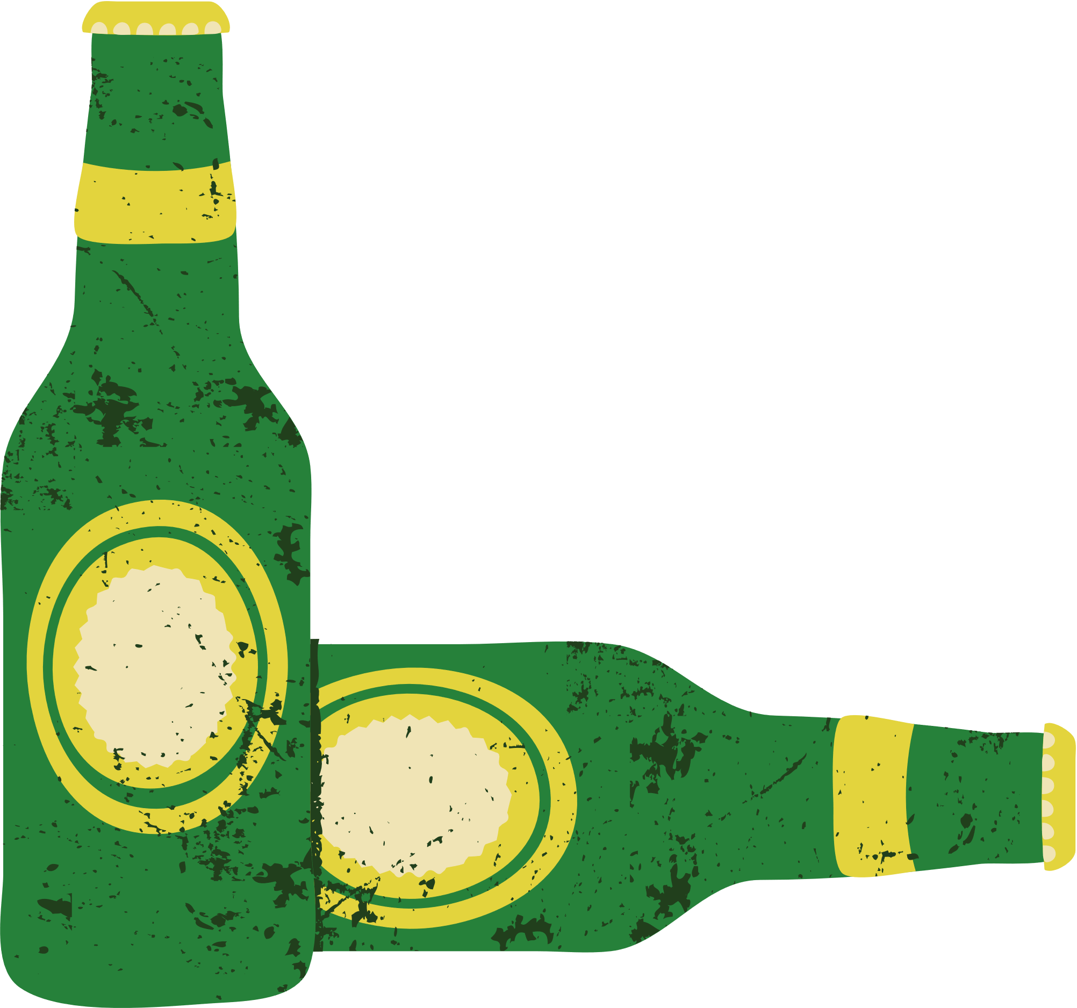
We choose k=2 rather than k=3 for DA?
1. Improved overall accuracy (61% > 43%)
This indicates that the model's classification performance is better.
2. Significant improvement in Segment 2's classification accuracy
At K=3, Segment 2 had only 46% accuracy, but at K=2, it increased to 82%.

Slide 15
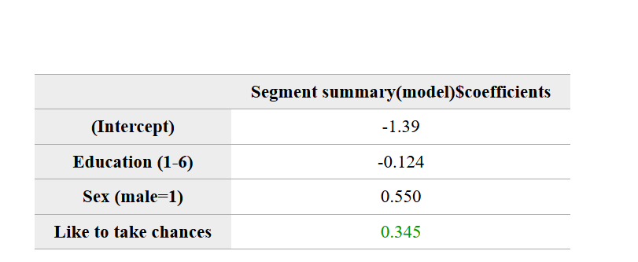
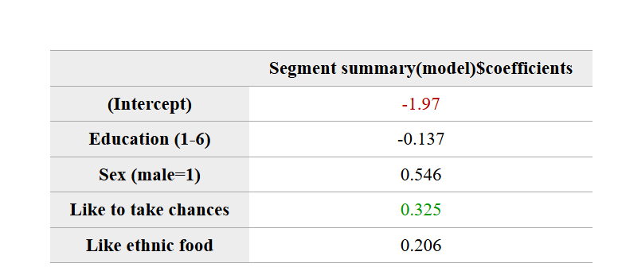
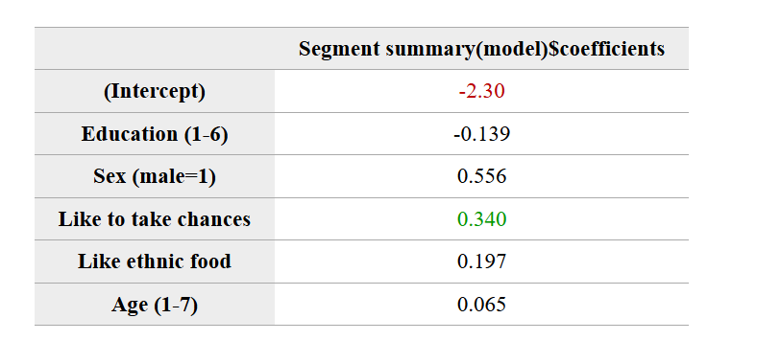
The global hit rate of the model is 59%.
Add: Like ethic food
The global hit rate of the model is 61%.
Add: Age
The global hit rate of the model is 59%.

Slide 16
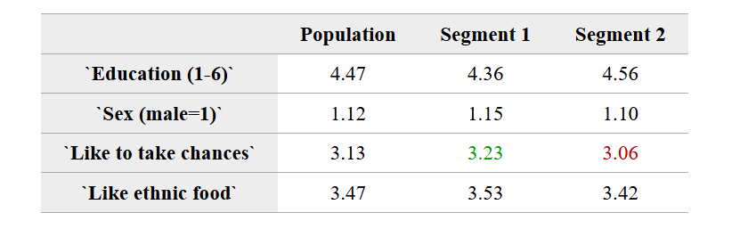
Conclusion :
Segment 1 :is more willing to try
Segment 2: More Conservative

Slide 17
Suggestions for Marketing Strategy
Segment 1 :
BrewDog – Known for experimental, high-ABV beers and bold marketing strategies. Strategy:
Launch limited-edition craft beers (e.g., seasonal or barrel-aged experiments).
Partner with celebrities or influencers for exclusive collaborations.
Host beer-tasting events and offer early access to new brews via memberships
Segment 2:
Guinness – A heritage brand with strong quality positioning. Strategy:
Focus on storytelling about brewing techniques and history.
Use expert endorsements and brand ambassadors (e.g., Michelin-starred chefs).
Partner with high-end restaurants and whiskey distilleries for premium pairing experiences.

